Slide 1

Exploring New Spectroscopy Methods for Collinear Ion Beams
Jovan Jovanovic (University of Cambridge)
Supervisor: Dr. Ronald Fernando Garcia Ruiz (CERN)

Slide 2
Table of Content:
Goals and Motivation
The Model and the Theory
Benchmarks against the old Experiments
Hypothetical Experiments (based on the old):
Doppler Switch
Cross Laser Ramsey Setup (*)
Near Degeneracy Probe (*)
Summary and Future Plans

Slide 3
Goal: Higher Precision in CLS
Rabi Type → Ramsey Type
Increased precision

Slide 4
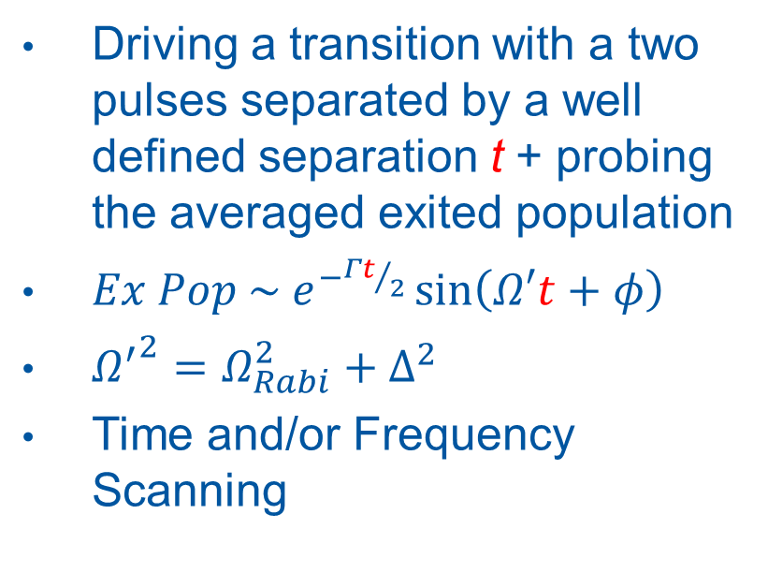
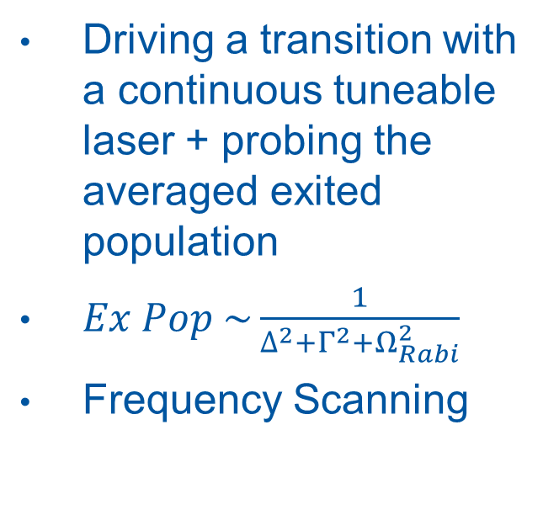
Goal: Higher Precision in CLS
Rabi
Ramsey
Driving a transition with a continuous tuneable laser + probing the averaged exited population
$Ex Pop \sim \frac{1}{Δ^{2}+Γ^{2}+Ω_{Rabi}^{2}}$
Frequency Scanning
Driving a transition with a two pulses separated by a well defined separation t + probing the averaged exited population
${Ex Pop \sim ⅇ}^{−{Γt}/2}\sin\left(Ω′t+φ\right)$
${Ω^{′}}^{2}=Ω_{Rabⅈ}^{2}+Δ^{2}$
Time and/or Frequency Scanning

Slide 5
Goal: Higher Precision in CLS
Rabi Type → Ramsey Type
Increased precision
Removal of Power Broadening
No more Frequency Scanning
Partial removal of Lifetime Broadening

Slide 6
Motivation:
Searching for New Physics using the Isotope Shift
Accessing New Observables

Slide 7
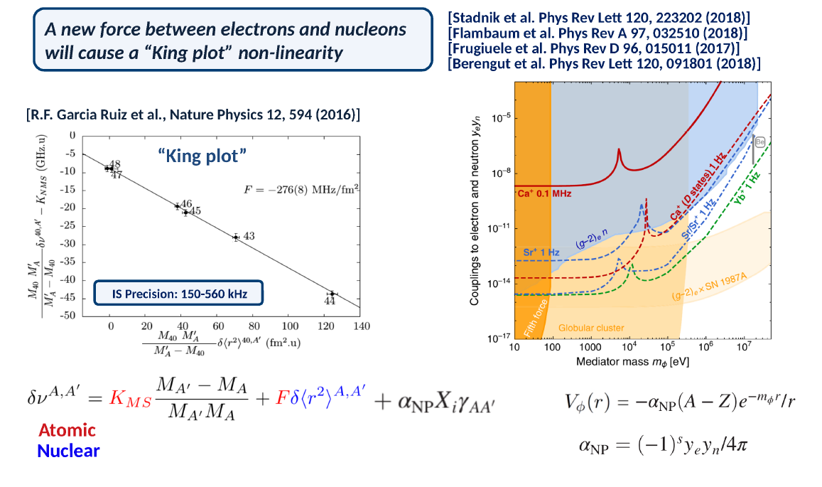
Motivation: Isotope Shift

Slide 8
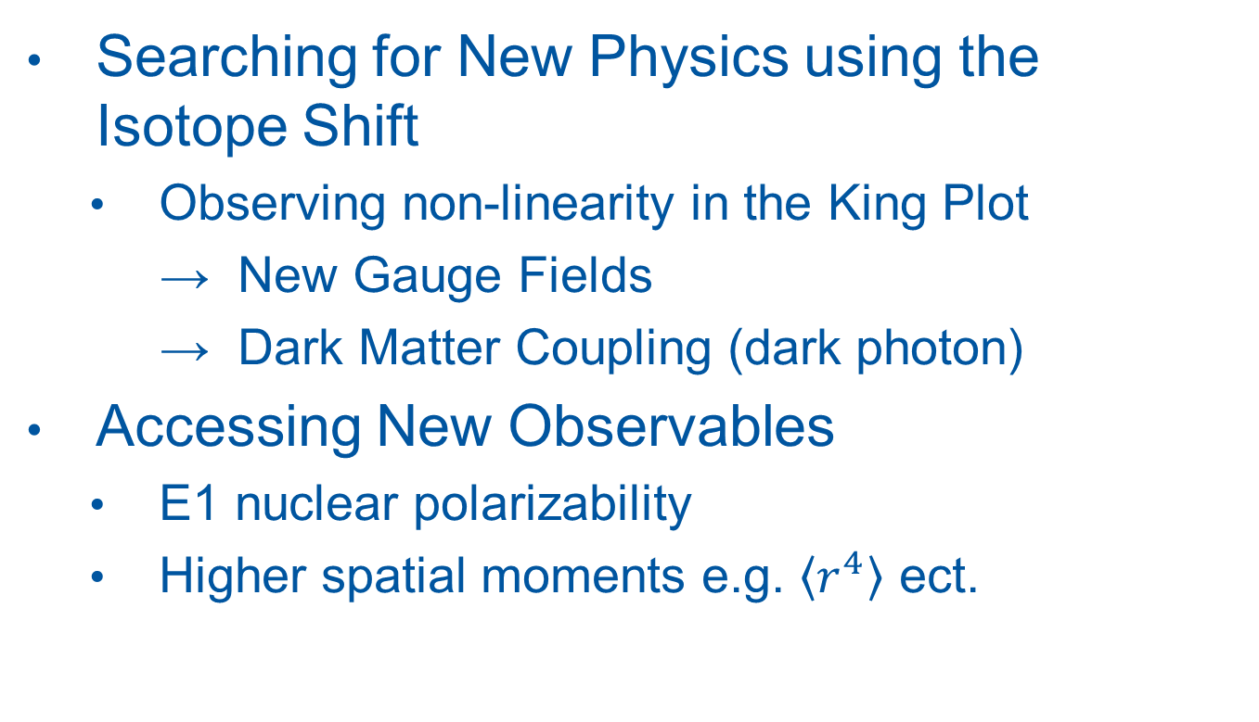
Motivation:
Searching for New Physics using the Isotope Shift
Observing non-linearity in the King Plot
→ New Gauge Fields
→ Dark Matter Coupling (dark photon)
Accessing New Observables
E1 nuclear polarizability
Higher spatial moments e.g. $\left\langle r^{4}\right\rangle$ ect.

Slide 9
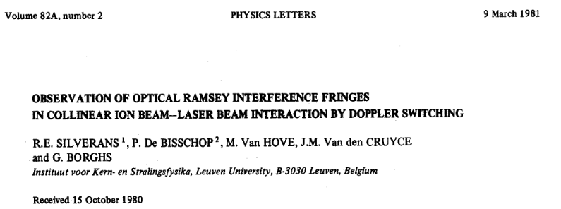
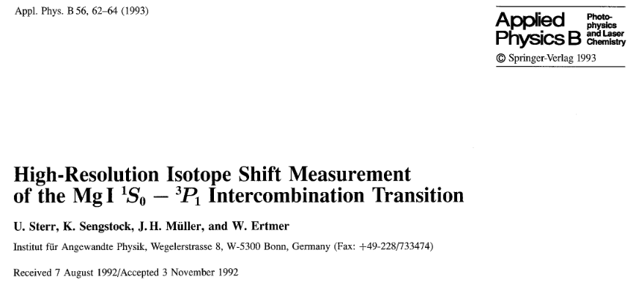
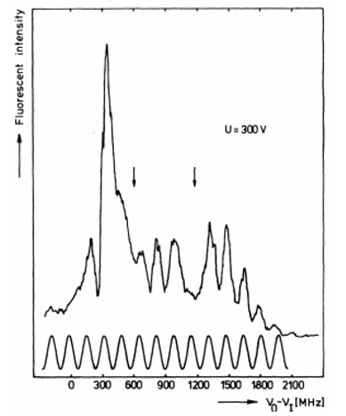
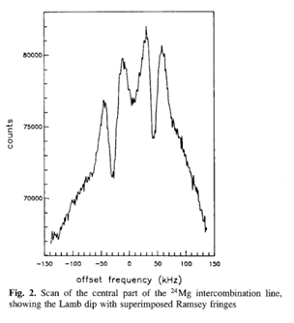
Motivation: Previous Attempts
Failed due to poor understanding of the line shape. Insufficient computing to model this.

Slide 10
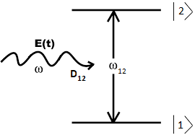

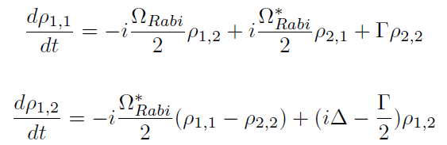
The Model:
Two Level System Coupled
to a Single EM Mode:
Work in Density Matrix Formalism → Maxwell-Bloch Equations:

Slide 11
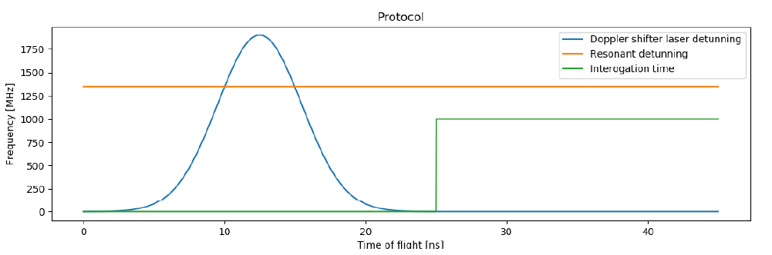
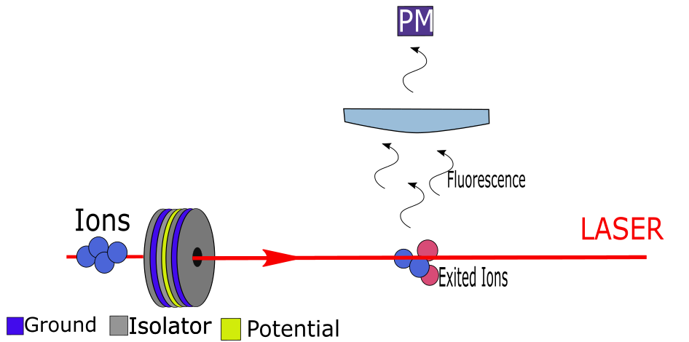
Benchmarks against Experiments
My Model vs Borghs et al. (1981)

Slide 12
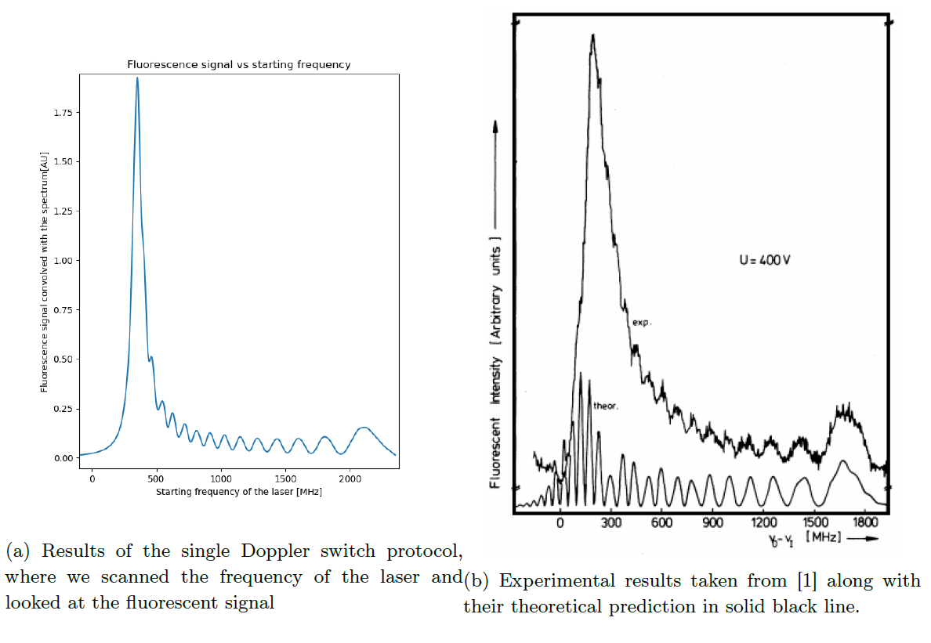
Benchmarks against Experiments

Slide 13
Benchmarks against Experiments

Slide 14
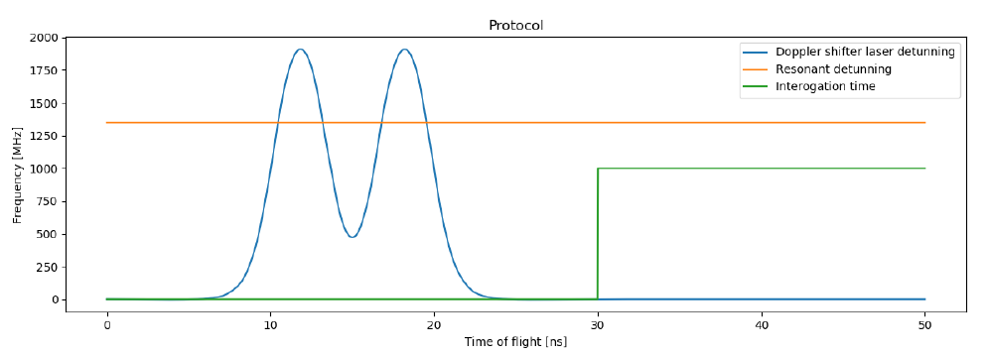
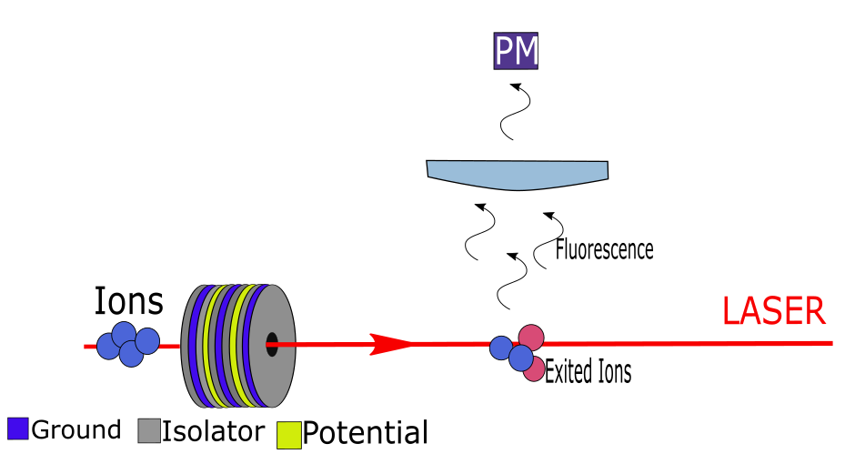
Benchmarks against Experiments
My Model vs Silverans et al. (1981)
ES ← COMSOL

Slide 15
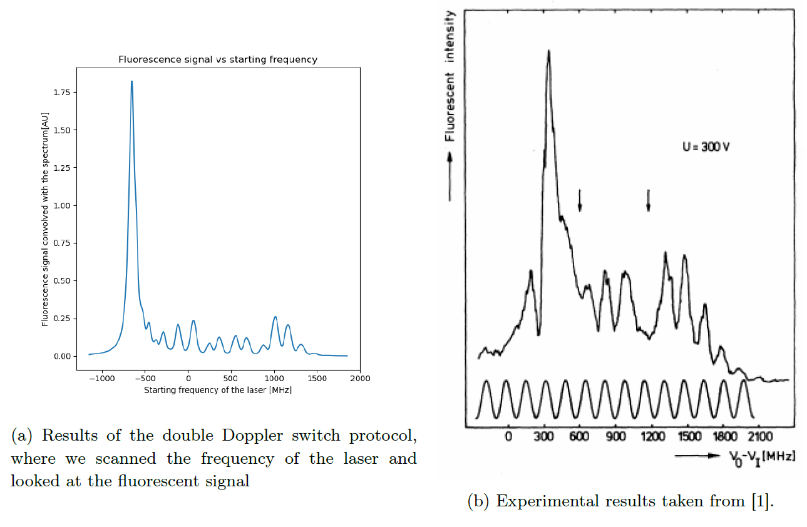
Benchmarks against Experiments

Slide 16
Benchmarks against Experiments

Slide 17
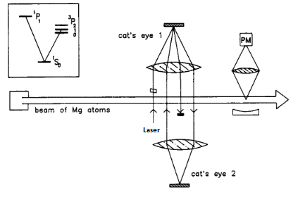
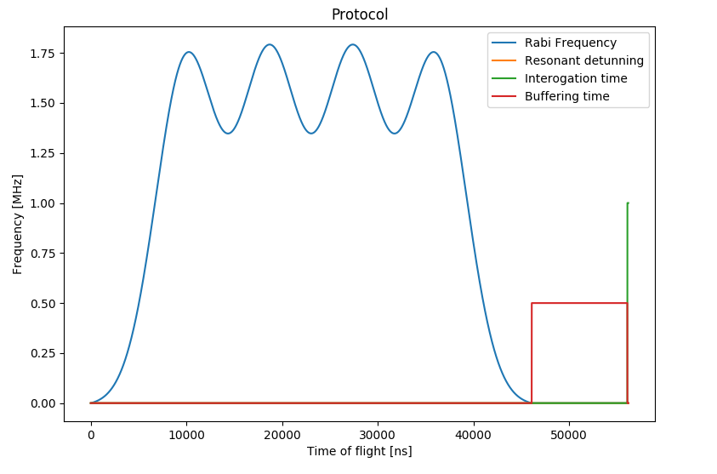
Benchmarks against Experiments
My Model vs Sterr et al. (1992)

Slide 18
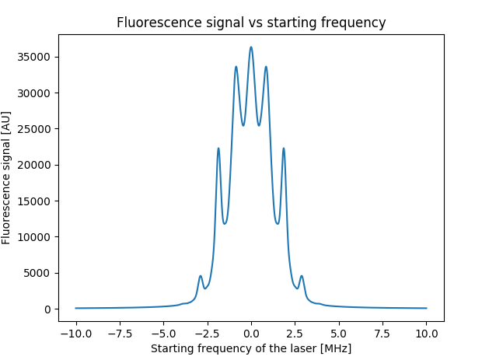
Benchmarks against Experiments
Around 8x reduction w/r to the natural linewidth
Scales are not crucial.

Slide 19
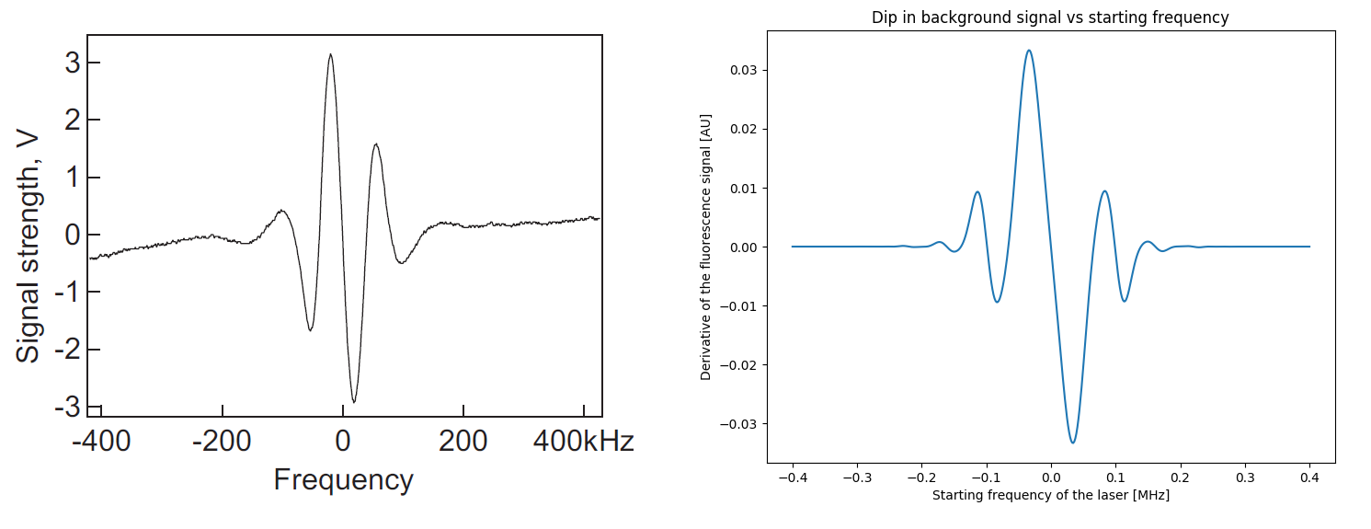
Benchmarks against Experiments
Mc Ferran et al. (Similar Cross Geometry as in Sterr et al.)

Slide 20
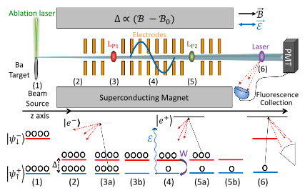
Benchmarks against Experiments
Altuntas et al. (2018) – not modelled yet

Slide 21
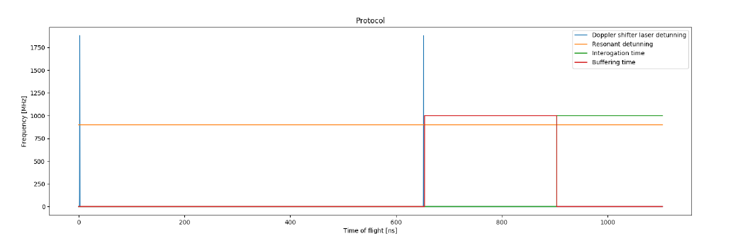
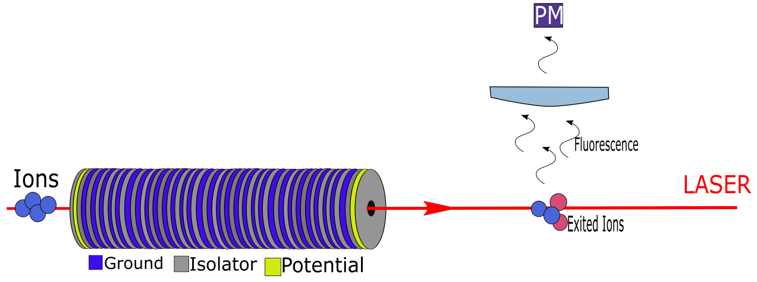
Double Switch: Design and Scanning Protocol

Slide 22
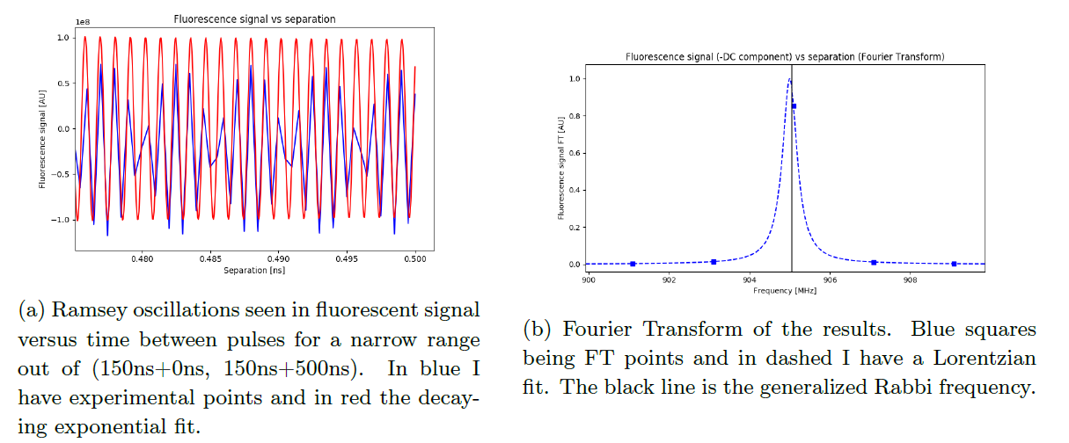
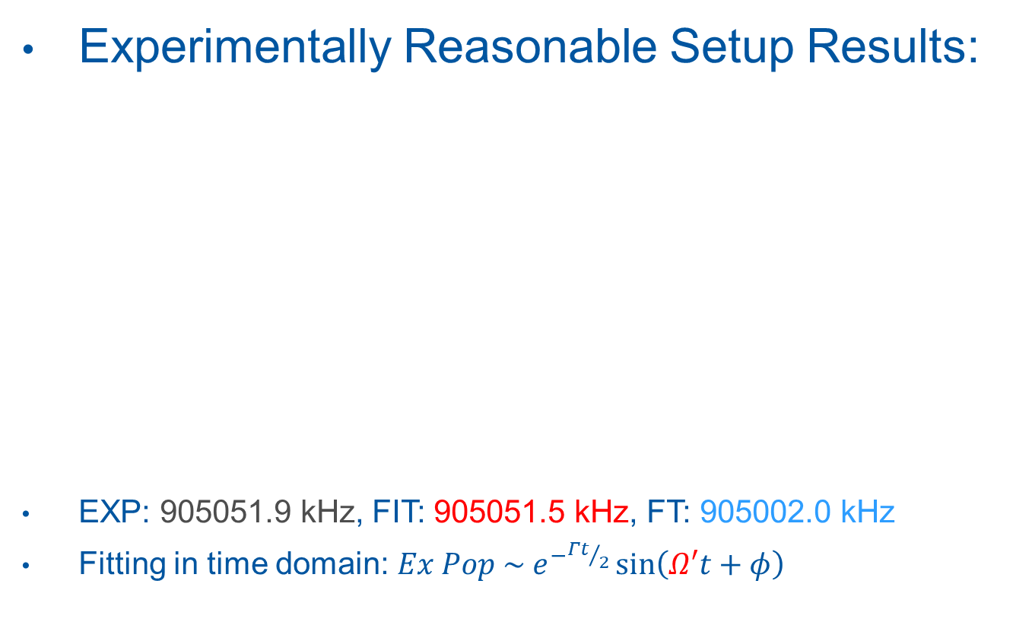
Doppler Switch
Experimentally Reasonable Setup Results:
EXP: 905051.9 kHz, FIT: 905051.5 kHz, FT: 905002.0 kHz
Fitting in time domain: ${Ex Pop \sim ⅇ}^{−{Γt}/2}\sin\left(Ω′t+φ\right)$

Slide 23
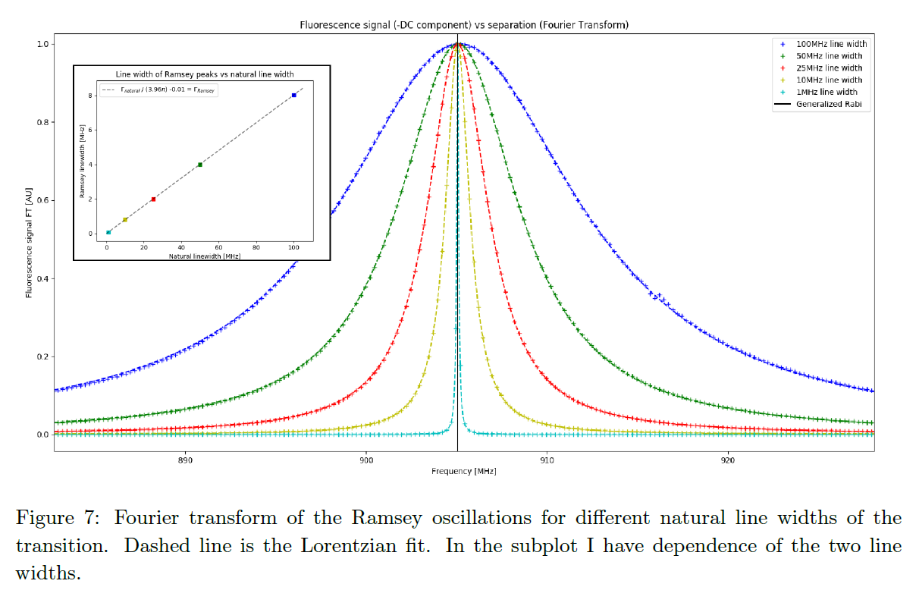
Doppler Switch
Line Shape Analysis (Super Experiment):
Lorentzian Shape

Slide 24
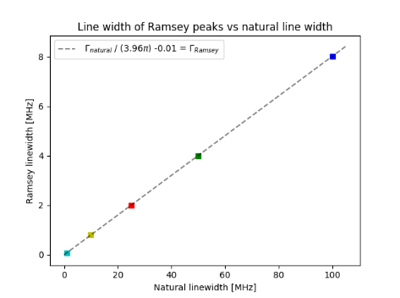
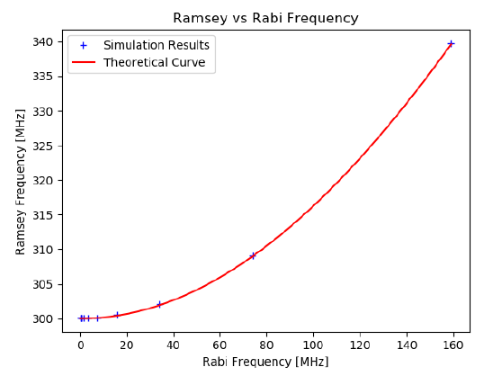
Doppler Switch
No Power Broadening
Power factors in only as AC Stark Shift

Slide 25
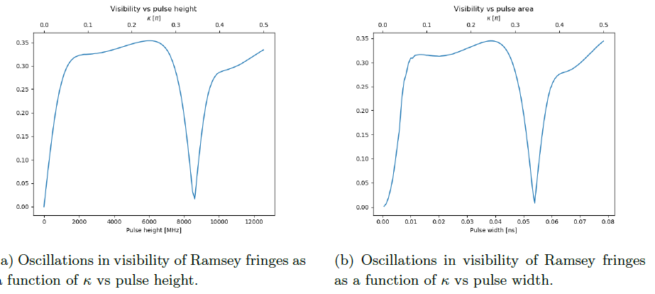
Doppler Switch
Pulse Shape Optimization
Only the Area factors in (Theoretically Understood)

Slide 26
Conclusions and Summary
Line-shapes measured in the Reference Papers are now well understood and modelled well
Even Low Quality Doppler Switch Setup Promises Sub-kHz Precision
Works Only for Ions
For Atoms One must use Cross Laser RS and for Molecules Near-Degenerate Probe

Slide 27
Future Plans
Future Plan is to do the Same Analysis for the other Two Devices (Experimental Benchmark and Precision Analysis)
For all Three Setups: Monte Carlo Simulations to take Thermal Broadening and Laser Linewidth into account

Slide 28
Thank you for your attention!

Slide 29
References
Acknowledgments
Dr. Ronald Garcia Ruiz
Dr. Adam Vernon
CERN, ISOLDE
Gustaaf Borghs et al. Physical Review Letters, 46(16):1074, 1981.
RE Silverans et al. Physics Letters A, 82(2):70–72, 1981.
Sterr, U et al. Applied Physics B 56.2 (1993): 62-64.
John J. McFerran and Andre N. Luiten, J. Opt. Soc. Am. B 27, 277-285 (2010)
Altuntaş, Emine, et al. Physical Review A 97.4 (2018): 042101.

